Slide 1
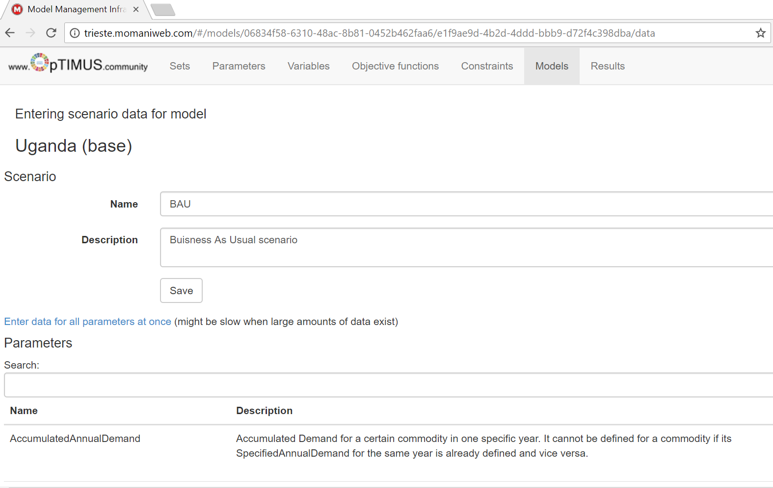
What is MoManI: an interface for OSeMOSYS

Slide 2
MoManI: an interface for OSeMOSYS

Slide 3
MoManI: an interface for OSeMOSYS
For this exercise, please consult at any point the User Manual of MoManI as needed.
If you still have problems understanding any function of MoManI, please post your questions on this forum.

Slide 4
Key parts of MoManI
To modify the OSeMOSYS code, if needed (wo won’t, everything pre-filled)

Slide 5
Key parts of MoManI
To feed ALL user inputs

Slide 6
Key parts of MoManI
To view and download the results

Slide 7
Key parts of MoManI
We’ll be using ONLY THESE TWO!

